Slide 1
Cardiac MRI- Basics and its application in cardiomyopathy

Slide 2
References
Braunwald’s heart disease: A textbook of cardiovascular medicine-12th edition
Ridgway JP. Cardiovascular magnetic resonance physics for clinicians: part I. Journal of cardiovascular magnetic resonance. 2010 Oct 7;12(1):71.
Tseng WY, Su MY, Tseng YH. Introduction to cardiovascular magnetic resonance: technical principles and clinical applications. Acta Cardiologica Sinica. 2016 Mar;32(2):129.
Broadbent D, Kidambi A, Biglands J. Cardiovascular Magnetic Resonance Physics for Clinicians Pocket Guide.
Soler R, Méndez C, Rodríguez E, Barriales R, Ochoa JP, Monserrat L. Phenotypes of hypertrophic cardiomyopathy. An illustrative review of MRI findings. Insights into Imaging. 2018 Dec;9:1007-20.
Oda S, Kidoh M, Nagayama Y, Takashio S, Usuku H, Ueda M, Yamashita T, Ando Y, Tsujita K, Yamashita Y. Trends in diagnostic imaging of cardiac amyloidosis: emerging knowledge and concepts. Radiographics. 2020 Jul;40(4):961-81.
Dorbala S, Cuddy S, Falk RH. How to image cardiac amyloidosis: a practical approach. Cardiovascular Imaging. 2020 Jun 1;13(6):1368-83.

Slide 3
References
Cipriani A, Mattesi G, Bariani R, Cecere A, Martini N, De Michieli L, Da Pozzo S, Corradin S, De Conti G, Zorzi A, Motta R. Cardiac magnetic resonance imaging of arrhythmogenic cardiomyopathy: evolving diagnostic perspectives. European Radiology. 2023 Jan;33(1):270-82.
Te Riele AS, Tandri H, Bluemke DA. Arrhythmogenic right ventricular cardiomyopathy (ARVC): cardiovascular magnetic resonance update. Journal of Cardiovascular Magnetic Resonance. 2014 Dec 5;16(1):50.
Lehtonen J, Uusitalo V, Pöyhönen P, Mäyränpää MI, Kupari M. Cardiac sarcoidosis: phenotypes, diagnosis, treatment, and prognosis. European Heart Journal. 2023 May 1;44(17):1495-510
Umer M, Kalra DK. Cardiac MRI in Fabry disease. Frontiers in Cardiovascular Medicine. 2023 Feb 2;9:1075639.
Galea N, Polizzi G, Gatti M, Cundari G, Figuera M, Faletti R. Cardiovascular magnetic resonance (CMR) in restrictive cardiomyopathies. La radiologia medica. 2020 Nov;125:1072-86.

Slide 4
Outline
Basic physics
Machine built
Resonance and precession
T1 and T2 relaxation
Significance of T1 and T2 values
Pulse sequence
Contrast weighted imaging
Synchronization and gating
CMR sequences
CMR in cardiomyopathies
HCM
ARVC
Amyloidosis
Sarcoidosis
Fabry’s disease
LVNC
IOC

Slide 5
History
Felix Bloch in 1940 proposed that atomic nuclei have properties that allow them to behave like a tiny magnets
He published a theory stating that charged particle spinning around its axis would have a magnetic field
Raymond Damadian in 1970- imaging of tumour in a rat
In 1977, the first image of a human volunteer was acquired
Overtime, MRI progressed from imaging static objects to moving objects with evolution of newer techniques

Slide 6
Machine built
Notes:
Strong magnetic field is generated by main magnetic coils
Gradient coils generates a magnetic field in same direction as B0, but with a strength that changes with position along x,y and z-axis
RF coil generated RF pulse-smaller amplitude than other magnetic fields
RF receiver coil- to detect the emitted MR signals

Slide 7
Magnetic resonance
Physical property of a nucleus that has an odd number of protons and/or neutrons
Most abundant nucleus is hydrogen proton (H1)
These possess an intrinsic property known as nuclear spin- magnetic moment for each proton
Randomly oriented
When a person is placed in a static magnetic field B0, the magnetic moment u of the hydrogen proton, also known as spin, rotates about the direction of B0 (z-direction)

Slide 8
Precession
In order to generate MR signal, RF field is applied with a frequency called Larmor frequency
In presence of B0, the protons precess or ‘wobble’ around the B0 axis (frequency of precession)
Larmor frequency proportional to the strength of magnetic field
Notes:
Larmor equation: Larmor frequency is product of gyromagnetic ratio and strength of magnetic field

Slide 9
Magnetic resonance (cont.)
RF pulse, of same frequency, if applied to these spins, the spins will absorb the energy from the RF pulse (resonance) and M0 will be tilted away from z-direction
2 components are formed: one along z-direction and other along the plane perpendicular to z-plane (xy-plane)
These two components of magnetisation are known as longitudinal magnetisation (Mz) and transverse magnetisation (Mxy)
Excitation pulses: 90 degree and 180 degree pulse
Notes:
Transmitted RF pulse: Net magnetisation tips into the transverse plane
Received RF signal: After B1 is turned off the transverse component of the net magnetisation, Mxy , continues to precess around B0. This moving magnetic moment will induce a voltage in a conducting coil placed nearby (RF receiver coil). This voltage is measured as MR signal

Slide 10
RF pulse
Saturation pulse
Inversion pulse
Notes:
90 degree RF pulse causes all net magnetisation from z-axis into xy-plane, leaving no component of magnetisation along z-axis- known as Saturation pulse
180 degree RF pulses can be of two types: refocussing pulse (spin echo) and inversion pulse
RF with low flip angle alpha is used in gradient echo pulse sequence: to control the amount of magnetisation that is transferred between z-axis and xy-plane

Slide 11
Relaxation
Longitudinal relaxation- recovery
Transverse relaxation- decay
When RF pulse is turned off, magnetisation gradually returns to its equilibrium state and becomes M0 again
The process of returning to the equilibrium state is called relaxation
Magnitude of Mz increases towards the magnitude of M0, whereas the magnitude of Mxy decreases to zero
Relaxation process in Mz is called longitudinal relaxation
Relaxation process in Mxy is called transverse relaxation

Slide 12
T1 and T2
Decay is always faster than recovery
The time taken for Mz to increase from zero to 63% of M0 is called T1
The time taken for Mxy to decrease to 37% of Mxy at the beginning is called T2
The length of T1 is related to the energy exchange between proton spins and its surrounding molecules (spin-lattice interaction)
The length of T2 is related to the energy exchange between any two proton spins (spin-spin interaction)
T1 and T2 values depend on characteristics of the tissue and their differences provide the source of image contrast in MRI

Slide 13
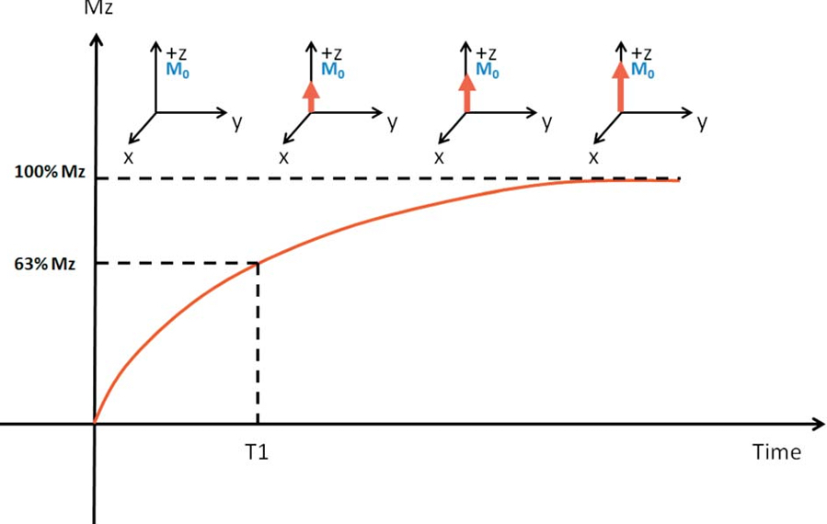
T1 relaxation
Shorter the T1, faster relaxation and return to equilibrium
Notes:
Exponential process: Recovery along z-axis occurs rapidly initially, slowing down as it approaches its equilibrium value

Slide 14
T2 relaxation
Net magnetisation = sum of all magnetic moments
In phase and out of phase
Two physical reasons exist for the decay of the total received Mxy signal:
Spins may dephase relative to each other due to genuine spin-spin interactions (T2)
Dephasing due to tissue inhomogeneity (T2’)
The combined dephasing effect of T2 and T2’ is known as T2*
Usually T2 time is more than T2*
Notes:
Cumulative decay rate T2* is much shorter than T2

Slide 15
T2 relaxation
Notes:
The signal that RF receiver coils detects is seen as oscillating magnetic field that gradually decays, known as FID

Slide 16
T2 relaxation

Slide 17
Significance of T1 and T2 values
Spin-lattice interaction
T1 relaxation = Energy release = Size of molecules = Molecular motion/Tumbling rate
Spin-spin interaction
Fat- Short T1 and moderate T2/T2*
Soft tissue- Moderate T1 and short T2/T2*
Fluid- Long T1 and long T2/T2*
Notes:
Lipid molecules have tumbling rate close to Larmor frequency-shortest T1
Larger molecules- slower tumbling rates- long T1
Free water has small molecular weight, but faster molecular tumbling rate, has long T1
The tumbling rates of water molecules that are adjacent to large macromolecules can however be slowed down towards Larmor frequency, shortening the T1 value. (e.g., muscle).
Free water has small molecules, which are relatively far apart: T2 relaxation is slow/long T2 time
Muscle has shortest T2- making hydrogen ions to interact more.

Slide 18
Pulse sequence
FID produces MR signal
MR signal is measured in form of an echo
Defined as a train of RF pulses that are used to produce MR signals
Different sequences can produce different signals from the tissue, depending on the imaging parameters and inherent T1 and T2 values
Two major pulse sequences used are:
Spin echo (SE) sequence
Gradient echo (GRE) sequence
Notes:
Magnetic field gradients that are used to localise and encode the MR signals in space cause additional de-phasing which leads to disruption of FID

Slide 19
Spin-echo sequence
90⁰ RF pulse is first applied to rotate the magnetisation M0 from z-direction to the xy-plane
Transverse magnetisation induced MR signal, called free induction decay or FID, begins to decay due to transverse relaxation
180⁰ RF pulse is applied to refocus the decaying transverse magnetisation and produce a echo called, called ‘spin echo’

Slide 20
Spin echo
Notes:
Because the sign of their phase shifts has been swapped halfway through by 180 degree refocussing pulse, the spins all come back into phase causing the FID to increase in amplitude, reaching a maximum at echo time

Slide 21
Gradient echo sequence
Generated by controlled application of magnetic field gradients
Magnetic field gradients are used to produce a change in field strength and hence corresponding change in Larmor frequency along a particular direction
Dephasing or loss of coherence occurs, causing FID signal to drop to zero
Dephasing is reversed by applied a second magnetic gradient along the opposite direction causing re-appearance of FID, generating a gradient echo

Slide 22
Gradient echo

Slide 23
Gradient echo variants
Property | Spoiled Gradient echo | bSSFP
Definition | Transverse magnetisation is destroyed before the end of the TR period using a spoiler gradient or RF pulse, so that it doesn’t contaminate subsequent lines of k-space | Remnant magnetisation is preserved using a balanced gradient scheme
Blood to myocardium contrast | Variable | Good
Flow sensitivity | High | Low
Image quality | Low SNR | High SNR
Notes:
Due to small flip angles used in gradient echo, it is possible to have such a short TR that the transverse magnetisation in Mxy direction has not fully dephased when the next RF pulse is applied. The remnant transverse magnetisation is destroyed before the TR using a spoiler gradient.

Slide 24
Image production
MR echo signals produced can be localised and encoded by applying magnetic field gradients to generate an image
3 steps:
Slice selection: Slice selection gradient, Gs
Phase encoding: Phase encoding gradient (Gp) signal encoding in y-axis
Frequency encoding: Frequency encoding gradient (Gf) signal encoding in x-axis

Slide 25
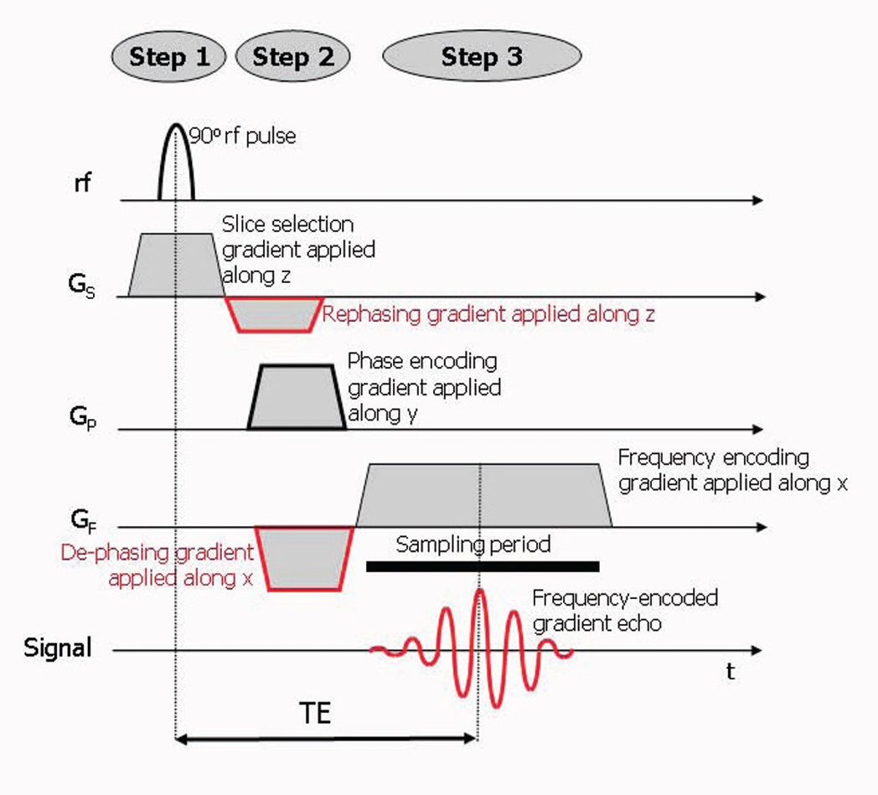

Slide 26
Echo time
Time between excitation pulse and the signal data acquisition (T.E)
Longer the TE, T2/T2* weighting increases (due to increases relative differences in signal due to transverse decay)
Short TE minimises the difference and maintains high signal and SNR

Slide 27
Repetition time
Repetition time refers to amount of time between the excitation pulses (T.R)
Longer TR allows near complete recovery for all tissues, so that differences due to T1 recovery are small and SNR is high
Shorter TR increases the relative differences and increases T1 weighting

Slide 28
Weighting of images
 | TR | TE
T1-weighted | Short | Short
T2-weighted | Long | Long
Proton-density | Long | Short
T1W images are characterized by bright fat signal and low signal from fluid: used for anatomical imaging where high contrast is required between fat, muscle and fluid
T2W images are characterized by bright fluid and are useful for depicting fluid collections and characterisation of cardiac masses and oedema
PD- image anatomical structures without the need to introduce soft-tissue contrast
Notes:
T1W- increased by choosing scan parameters that enhance the relative differences in the longitudinal magnetisation at the time the readout pulse is applied
T2W- increased by choosing scan parameters that enhance the relative differences in the transverse magnetisation at the time the signal is received.

Slide 29
Synchronisation with ECG
Prospective gating
Retrospective gating
R-wave as a trigger to acquire a segment of k-lines in space within a short period of time
The same trigger-acquisition cycle is repeated in the following R-R intervals until all the necessary k-lines are collected
Acquisition window must be shorter than R-R interval, usually kept around 80-90% of the average R-R interval
Cannot image during end-diastole
Data is continuously acquired and retrospectively match the corresponding positions of the ECG gating
Capable of imaging the entire cardiac cycle
Notes:
Soft tissue movement (myocardium) and fluid flow makes imaging in the heart very challenging
Thus, ECG synchronisation is done
MRI compatible leads are attached and software detects the R-wave.
Once R-wave is detected → it initiates the pulse sequence controller so that pulse sequence is applied after a trigger delay

Slide 30
ECG triggered pulse sequence
Notes:
K-space is the name of the data array within which the multiple signal measurements that make up a single MR image is saved

Slide 31
Gating
Notes:
Cine imaging: Produces a movie showing a single slice of heart for each phase of cardiac cycle
Short trigger delay- systole, Long trigger delay- diastole
One line of k-space is acquired per R-R interval
In prospective triggering- average R-R interval is made prior to imaging to determine the number of cardiac phases to image. Dead space +
In retrospective triggering- data is continuously acquired throughout cardiac cycle. No dead space +

Slide 32
Respiratory gating
Notes:
Non-gated technique: Patient breath holding
Respiratory gated techniques: Monitor respiratory motion and only acquire data within a pre-defined window
Navigator echoes: Column of tissue is excited before acquiring each image using a specially designed RF pulse. A clear boundary is created between lungs and liver. The position of the boundary can then be detected and used as a measure of the diaphragm position.

Slide 33
Cardiovascular structure imaging
CMR can delineate cardiovascular structures with adequate spatial resolution and tissue contrast
To highlight myocardial or vascular wall signal, the signal from blood and fat needs to be suppressed
Inversion RF preparation pulses are added to suppress the signal from the blood and fat, called dark-blood imaging
Double IR technique: dark blood imaging
Triple IR technique: dark blood and dark fat imaging

Slide 34
Dark blood imaging
Two 180⁰ RF inversion pulses followed by spin echo sequence
First 180⁰ RF inversion pulse- not slice selective- inverts the magnetisation of blood and tissues within range of RF body transmitter coil
Second 180⁰ RF inversion pulse- slice selective- re-inverts the magnetisation only within the slice of tissue to be imaged
Net effect- invert the magnetisation of blood and tissue outside the slice, while magnetisation within the slice remains close to the equilibrium value

Slide 35
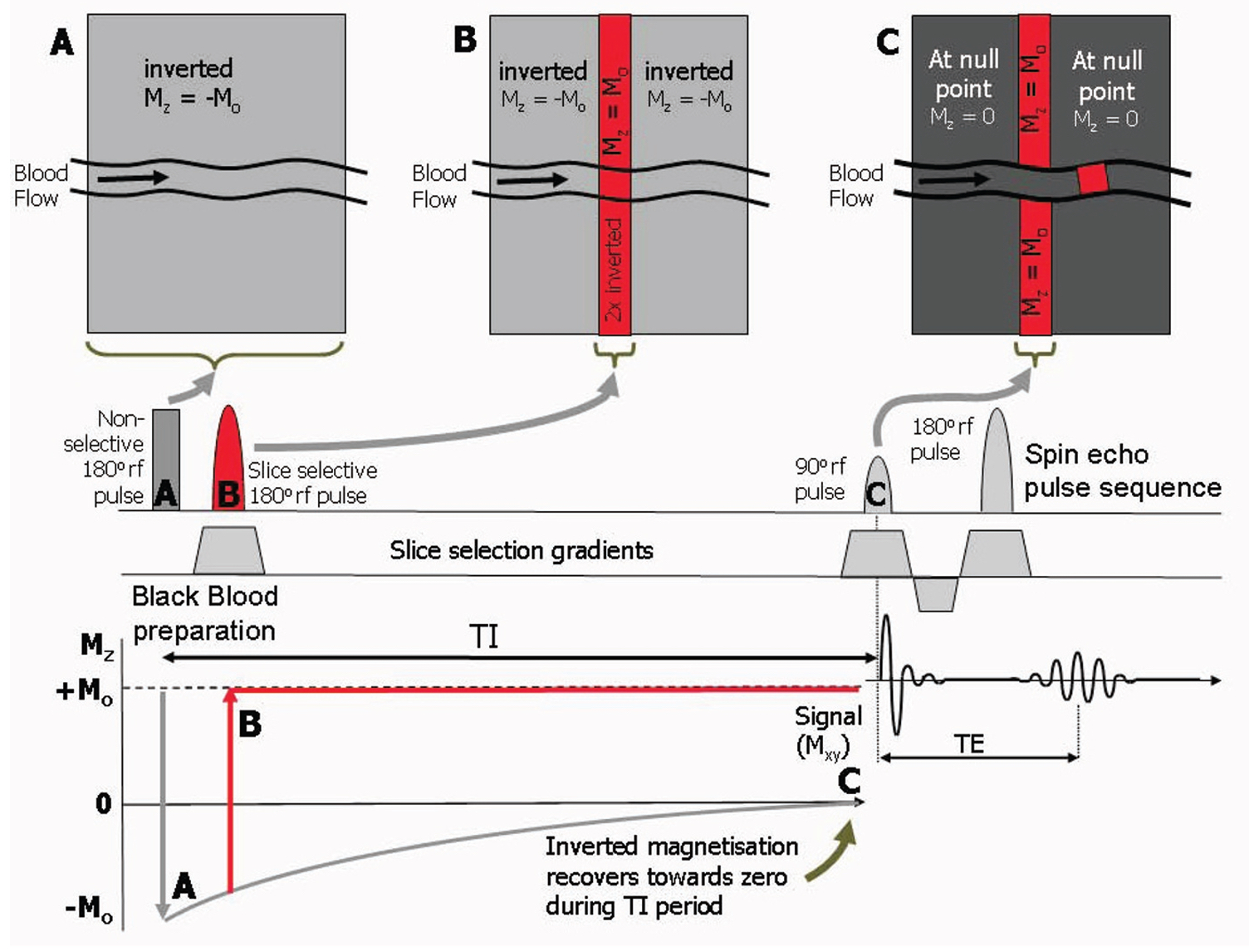
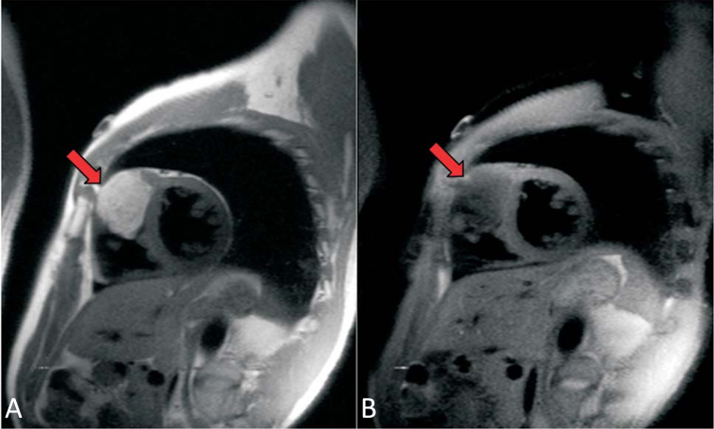
Notes:
Double inversion recovery (IR) dark-blood image in short axis view shows a bright intramural tumour protruding into the RV cavity

Slide 36
STIR sequence
Two 180⁰ pulses for black blood preparation, followed by a third slice-selective, 180⁰ pulse to provide the STIR contrast
The inversion pulse applied with a short T1 value- reduces the signal intensity from tissues (fat) with a shorter T1, so that tissues (water) with higher T1 relaxation times exhibit a relatively higher signal amplitude
Also called as- triple inversion recovery pulse or oedema imaging

Slide 37
Cine MRI
Technique that captures the images of the heart in motion through out the cardiac cycle, and displays the cardiac motion in a cine loop fashion
Periodic changes of the cardiac chambers and ventricular walls can be readily visualised
Quantify ventricular function and local wall motion, thus provides important information about cardiac function

Slide 38
Cine MRI (cont.)
Uses balanced steady-state free precession (bSSFP)
Rapid GRE sequence
Very short TR
High tissue contrast
Cine MRI is considered gold standard in the assessment of systolic function of the ventricle
Also used in evaluation of valvular insuffiency, outflow tract obstruction, dyssynchrony or asynchrony of ventricular walls and mobility of cardiac tumours

Slide 39
Late gadolinium enhancement MRI
Soluble gadolinium (Gd) chelated agent
Intravascular and intercellular space except brain
Normal and abnormal myocardium will show different concentration curves of Gd due to different kinetics
More intercellular space in infarcted or scarred myocardium
Gd shortens T1, thus abnormal myocardium shows signal enhancement.
Also exhibit T2/T2* shortening effect- smaller effect compared to effect on T1
Notes:
Normal myocardium- early washout of the contrast
Injured myocardium- washout is very slow- leading to delayed enhancement 10 min post-contrast
Pathophysiological scenarios leading to LGE:
Fibrosis
Increased extracellular space
Inflammation
Tumour neovasculature

Slide 40
LGE imaging
Contrast agent
6-8 min
T1 scout- for selection of T1 (inversion time)
Myocardial nulling
Post-contrast imaging
Normal myocardium
(Uniformly dark)
Abnormal myocardium
(Bright areas on the dark background)

Slide 41
LGE-MRI (cont.)
Performed using T1-weighted rapid GRE-sequence combined with an inversion recovery pre-pulse to the null the signal of normal myocardium
Expertise is needed to adjust the inversion-recovery null time so that normal myocardium is nulled and appears dark
Vivid contrast between normal and abnormal myocardium
Standard technique to determine myocardial scarring and has tremendous role in cardiomyopathy
Notes:
Correct inversion time (TI) is chosen to suppress the signal from normal myocardium(250ms)
Phase-sensitive IR (PSIR): nulls myocardium consistently over a range of TIs

Slide 42
Quantification of LGE
Predicting adverse outcomes in non-ischemic cardiomyopathy
Remote normal myocardium zone is defined
Threshold of signal intensity is kept +2 SD above average signal in remote zone (more than + 2 SD- scarred myocardium)

Slide 43
Myocardial T1 mapping
Diffuse interstitial myocardial fibrosis is not readily observable on LGE images
Modified Look-Locker inversion recovery (MOLLI) sequence: allows T1 quantification of myocardium
Non-contrast T1 mapping: sensitive alternative to LGE
Increased T1 time: myocarditis, amyloidosis, HCM
Decreased T1 time: iron overload cardiomyopathy and Fabry’s disease
Notes:
Replacement or scarring fibrosis: MI
Interstitial fibrosis: Reactive and infiltrative fibrosis
Reactive- HTN, DCM, volume/pressure overload
Infiltrative: Amyloid, Anderson-Fabry
Others sequences for T1 mapping: MOLLI, ShMOLLI, SASHA, SAPPHIRE

Slide 44
Myocardial ECV
Defined as a ratio of the change in the myocardium T1 to the change in the blood T1 (pre-contrast vs post-contrast)
Associated with severity of diffuse myocardial fibrosis in histology and diastolic function in HFpEF
More favourable than post-contrast T1 time to estimate extracellular expansion in diffuse myocardial fibrosis
Notes:
Measurement of post-contrast T1 time is affected by several factors such as magnetic field strength, timing of post-contrast MOLLI acquisition, type of MOLLI scheme, the amount of contrast injected and the subject’s renal function
ECV is less affected by these variables.

Slide 45
Myocardial T2 and T2* mapping
Long transverse relaxation time of water protons, thus T2 prolongs
Myocardial T2 mapping detects intramyocardial water and can quantify myocardial oedema
T2* relaxation: due to decay of transverse magnetisation caused by local magnetic field homogeneity
Sensitive to iron content of the tissue
T2* relaxation times are severely reduced in iron overload cardiomyopathy
Notes:
Principle: Long transverse relaxation (T2)

Slide 46
Phase contrast cine
Bipolar velocity gradient is added to cardiac gated GRE sequence to measure phase shift caused by the flowing blood
Phase shift is proportional to the flow velocity along the direction of bipolar gradient
Stationary tissue appears grey, whereas flowing blood appears white or black signal intensity, depending on the direction of the flow relative to velocity encoding gradient
Used for flow quantification of great vessels, regurgitant flow, estimation of cardiac shunts
Measure of pulse wave velocity of descending aorta- elasticity of aortic wall
Notes:
Acquires a series of images within a cardiac cycle with cardiac gating similar to cine MRI.

Slide 47
Imaging | Sequence | Applications
Cine imaging | bSSFP | Ventricular volumes/function, wall thickness and mass
 | Spoiled-GRE | Used in metal implants
 | Real-time GRE | Track beat to beat cardiac motion
Black/Dark-blood imaging | T1/T2/PD- weighted double IR FSE | Ventricular morphology and tissue characterisation T2W-IR-FSE: oedema detection
STIR | T2-weighted triple-IR FSE | Intra-extra-cellular oedema as in inflammation/necrosis
T1-mapping | MOLLI | Native T1-increased by inflammation, oedema, vasodilation, fibrosis, amyloid Decreased by fat and iron
T2-mapping | MESE, GraSE, T2-prep bSSFP | Native T2- increased by inflammation, oedema and decreased by iron
T2*-mapping | GRE | Native T2*- decreased by iron
Phase contrast | Spoiled GRE | Flow quantification across cardiac valves and vessels

Slide 48
Imaging | Sequence | Applications
Perfusion | IR-GRE or IR-SSFP post contrast | Myocardial perfusion
Early enhancement (EGE) | IR-GRE or IR-SSFP post contrast | Intracardiac thrombus detection
Late enhancement (LGE) | IR-GRE or IR-SSFP post-contrast | Extracellular Gd deposition with excellent SNR
 | 3D acquisition | Markedly hypointense areas within LGE correspond to no-reflow areas
ECV-mapping | MOLLI | Increased by necrosis, amyloidosis, oedema

Slide 49
CMR
Cause of cardiomyopathy
SSFP
LGE
First-pass perfusion
T1 and T2 mapping
T2* mapping
Extent of ventricular dysfunction
SSFP
Strain imaging
Portions of viable myocardium
SSFP
LGE
Strain imaging
Pattern of LV thickening and hypertrophy
SSFP
LGE
Strain imaging
T1 mapping

Slide 50
Dilated cardiomyopathy
Characterized by ventricular dilatation (LVDD >50 mm) and systolic dysfunction (LVEF <40%)
Can differentiate between ischemic and non-ischemic cardiomyopathy
Morphological and functional analysis was done with cine imaging
Segmental wall motion analysis: qualitatively or quantitively
Viability analysis: presence and extent of scar tissue across myocardial wall
Transmural index: Index 0-no enhancement, Index 1- 1-25%, Index 2- 26-50%, Index 3- 51-75%, Index 4- 76-100%

Slide 51
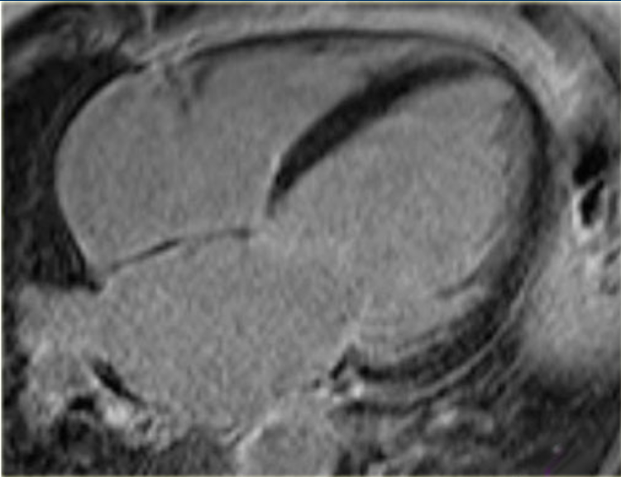
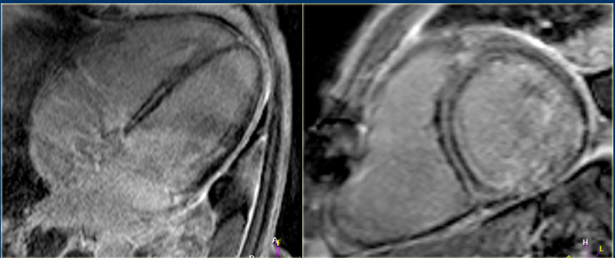
Notes:
Patient with idiopathic DCM- MR in left and no enhancement in the right picture

Slide 52
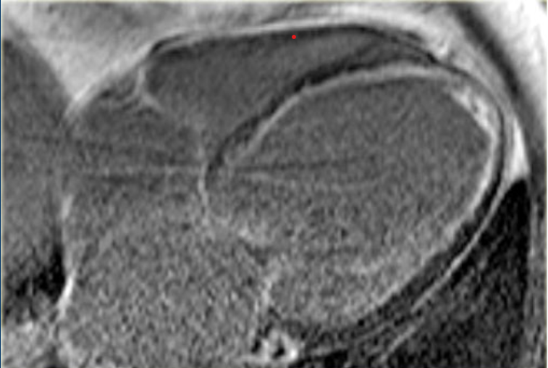
Notes:
Ischemic DCM
Figure on the right shows subendocardial enhancement

Slide 53
Hypertrophic cardiomyopathy
Genetic disorder characterised by increased in LV wall thickness (end-diastolic) of more than 15mm
Diverse phenotypic expressions
Microscopic findings- hypertrophy, disarray, interstitial fibrosis, dysfunction of coronary vasculature and silent myocardial ischemia
CMR is well suited to characterise the phenotypic expression of HCM
4 stages of HCM: subclinical phase, classical HCM phenotype, adverse remodelling phase and end-stage HCM
Notes:
Phenotypic variability: Not only myocardial hypertrophy, but other morphological and functional manifestations.
LV remodelling → progressive dilatation and thinning of its wall

Slide 54
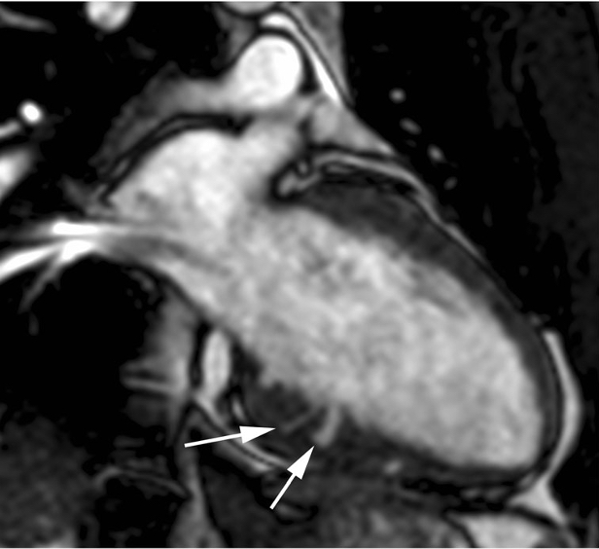
Subclinical HCM
Genotype-positive and phenotype-negative subjects
Myocardial crypts/clefts:
Congenital abnormality related to myocardial disarray
V or U-shaped blood filled myocardial invaginations perpendicular to endocardial LV edge the penetrate more than 50% of compact myocardium during end-diastole and collapse at end-systole
D/D- LVNC, congenital LV diverticula, congenital LV aneurysm
Notes:
Myocardial crepts <5% of HCM patients
Located in basal inferoseptal and inferior LV wall at sites of RV insertion
Trabeculations- diff by- not penetrating the compact myocardium
Cong LV diverticula- all three layers- narrow connection to cavity and collapse at end-systole- diff by- penetrating out of the epicardial border
Fig: 22 yr male with family history of HCM- SSFP image- myocardial crypts.

Slide 55
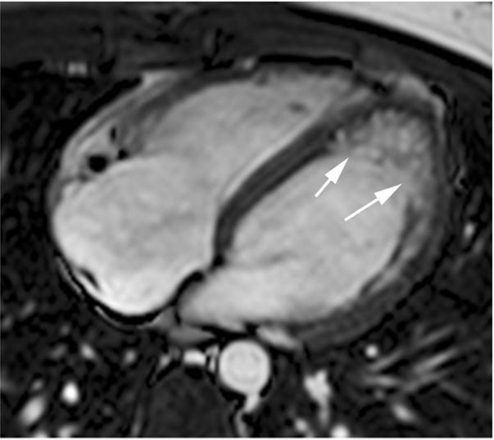
Subclinical HCM (cont.)
Mitral valve leaflets elongation
Myocardial trabeculations- ‘apical’
Myocardial fibrosis
ECV fraction increases in HCM in contrast to athletes (have increase in healthy myocardium by cellular hypertrophy)
Notes:
A-SSFP cine image elongated AML with normal PML. Aberrant muscular band
B- Apical trabeculations

Slide 56
Classic HCM
Classic phenotype is hypertrophied, non-dilated and hyperdynamic LV
MC location: confluence of basal anterior septum with the contiguous anterior free wall >> posterior septum at mid LV level
Massive hypertrophy- LV wall thickness more than 30mm
Mid-ventricular HCM: VA and systemic embolism
Apical HCM: Spade like configuration of LV cavity
RV hypertrophy: segments confined to ventricular septum
Notes:
Extent of hypertrophy: focal (<3), intermediate (3-7) or diffuse (>7)
Apical HCM 5-25%
Mid-ventricular HCM- Dangerous VAs

Slide 57
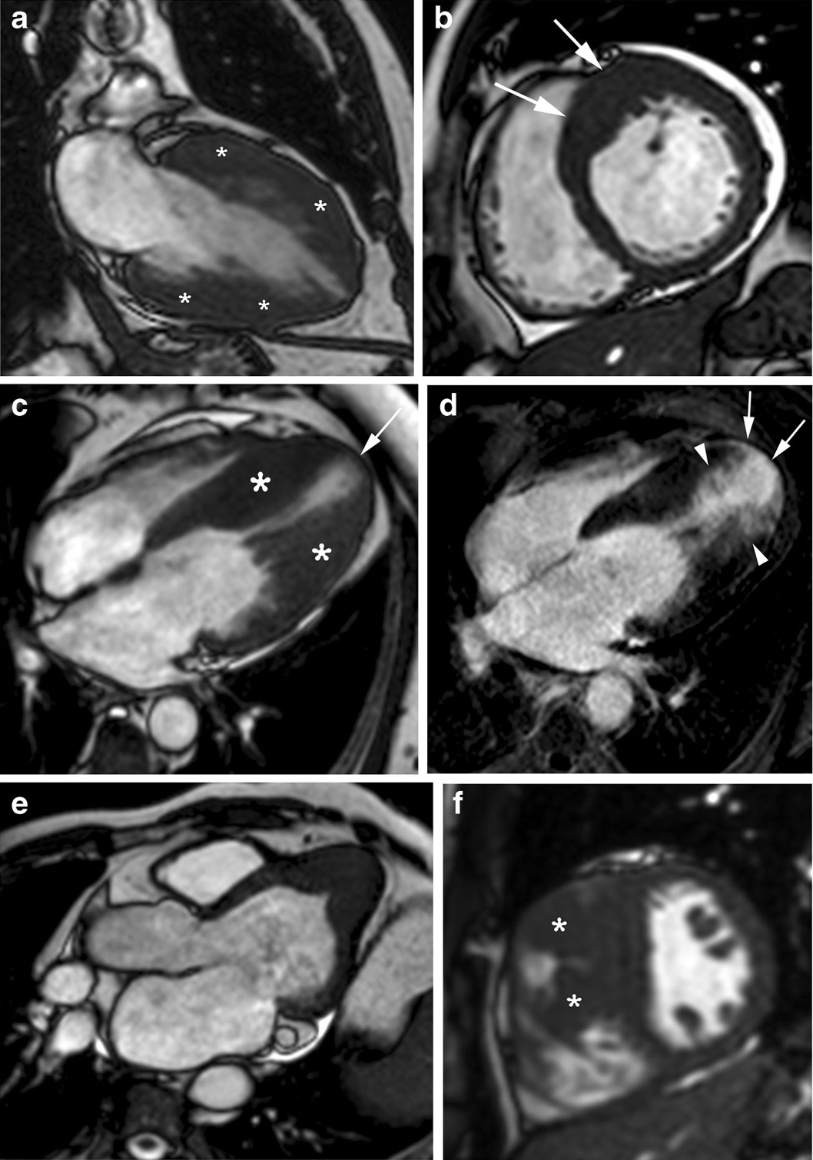
LV hypertrophy
Asymmetrical septal hypertrophy
Mid-ventricular
Apical
Concentric
Mass-like subtypes
Notes:
All are SSFP cine-images
C- Dumb-bell configuration of LV cavity with marked mid-ventricular gradient and apical aneurysm
D- apical aneurysm
E- Spade-like appareance
F- hypertrophied crista-supraventricularis muscle

Slide 58
Classic HCM (cont.)
Diastolic dysfunction: phase contrast MRI, myocardial tagging and 3D model-based analysis of LV fillings
Systolic anterior motion result of increased flow velocity and decreased pressure above the valve caused by hypertrophied IVS
MV apparatus:
Elongated mitral valve leaflets (34mm vs 24mm)
Hypertrophy of papillary muscle heads
Anterior and apical displacement of papillary muscles
Direct insertion of anterolateral papillary muscle to AML
LV accessory bundles
Double bifid morphology
Notes:
Myocardial tagging: enables the quantification of cardiac strain evolution during late diastole, assess diastolic myocardial dysfunction

Slide 59
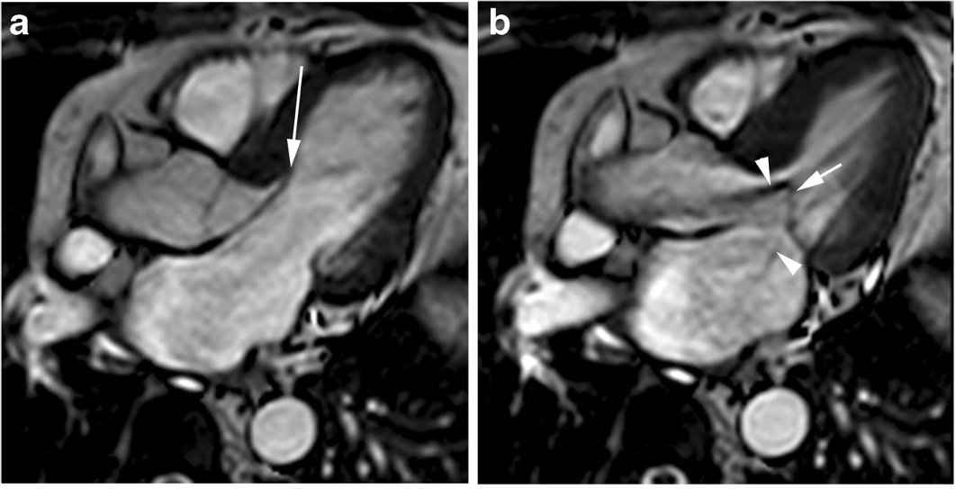
Notes:
A- end-diastole
B- end-systole- arrowheads depict turbulent LVOT and MR jet

Slide 60
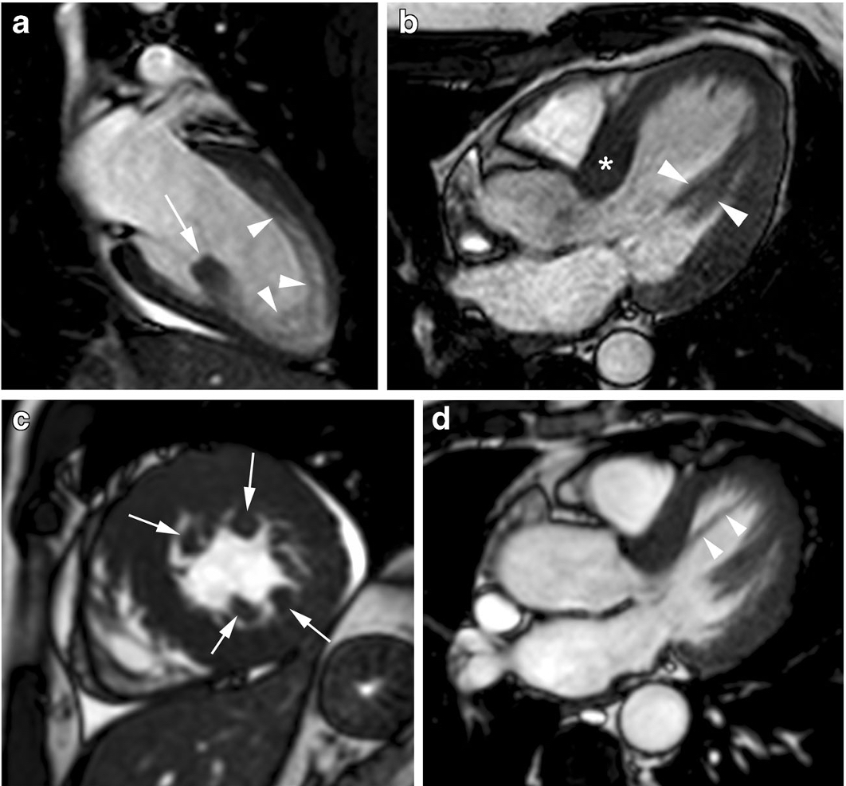
Notes:
A- isolated hypertrophied posterior papillary muscle with apical trabeculations
B- Anteroseptal HCM with bifid papillary muscle
C- Multiple accessory papillary muscles with conc LVH and pericardial effusion
D- Accessory muscle bundle from septum to apex

Slide 61
Classic HCM (cont.)
LA size- > 15cm²/m² in four-chamber view
Microvascular ischemia
Myocardial fibrosis
LGE at mid wall and RV insertion points on septum- MC
Higher than normal native T1 values
> 15% LGE as a risk stratification marker
LVOTO
Elongated AML
SAM
CMR derived planimetry of LVOT area at rest- cut off of 2.7 cm²
Notes:
Causes of LA dilatation: SAM related MR and elevated filling pressures of LV
Microvascular ischemia: PET/SPECT/first-pass perfusion cardiac MRI sequences- MC- subendocardium, mid wall, correlated with thickness
A- Mid septal enhancement
B- Mid wall septal enhancement
C- RV insertion points

Slide 62
Myocardial fibrosis
Notes:
A- septal hypertrophy
B- T1 values elevated in anteroseptal and lateral walls
C- Only small patchy enhancement in anteroseptum

Slide 63
Adverse remodelling
Progressive decreases in systolic and diastolic LV function
Moderate/severe LA and LV dilatation
Increase in symptoms and functional limitations
Atrial fibrillation
Reduction or loss of LVOTO
Progressive LV wall thinning
Multiple and confluent LGE at mid-wall or transmural distribution

Slide 64
End-stage HCM
Progressive LV wall thinning and LV wall dilatation
Decrease or disappearance of LVOT gradient
Restrictive pattern with a small LV and severe dilatation of both atria occurs
Mid wall or transmural LGE
Increased risk of SCD and heart failure complications

Slide 65
End-stage HCM (cont.)
Notes:
A- Regression of wall thickness, increased in LV cavity dimensions and reduced EF
B- STIR sequence showing transmural delayed enhancement >25% of myocardial mass
Below images- Transmural LGE of aneurysm rim with extension into anterior and inferior walls

Slide 66
Genotypic-phenotype relationship
Reverse curve: MYH mutation
Sigmoid curve: PKP2 mutation

Slide 67
Notes:
Pre and post-alcohol septal ablation
A- SAM + MR
B- Thinning of basal spetum + decreased LVOTO + Decreased MR

Slide 68
ACM
Genetic disease characterised by myocyte loss and fibrofatty replacement, primarily of the right ventricle
Increased risk of SCD and heart failure
Triangle of dysplasia- sub-tricuspid region of RV, RV apex and RVOT
Modified triangle of dysplasia- ‘displacement’ of RV apex and because of frequent involvement of posterolateral LV wall
2010 Task-Force criteria
Replaced by Padua criteria- involves left dominant disease phenotypes
Notes:
ARVD→ARVC→ACM
Akinesia- lack of motion
Dyskinesia- abnormal motion
Dysynchronous- regional peak contraction occurring at different times in adjacent myocardium

Slide 69
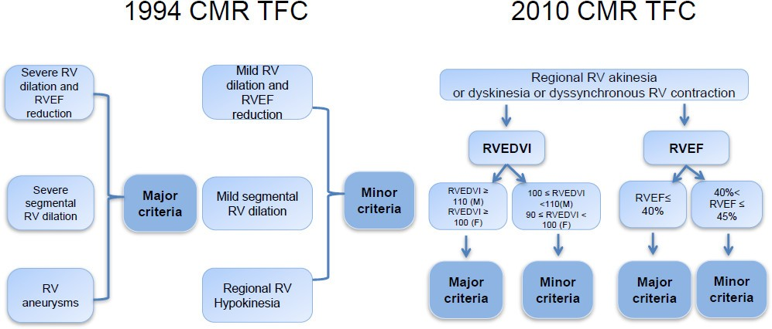
Notes:
1994- qualitative
2010-quantitative
Issues with 2010 ITF criteria:
CMR is not alone used in diagnosis-must include structural, ECG abnormalities, family data
Proposed RV EDV volumes were calculated using fast gradient echo which has lower contrast compared to conventionally used bSSFP (higher values are obtained)
Tissue characterisation of RV is not included-due to thin wall of RV
Lack of criteria for LV or biventricular phenotypes
Global or regional dysfunction and structural alterations
Tissue characterisation of wall (HPE)
Repolarisation abnormalities
Depolarisation/conduction abnormalities
Arrhythmias
Family history

Slide 70
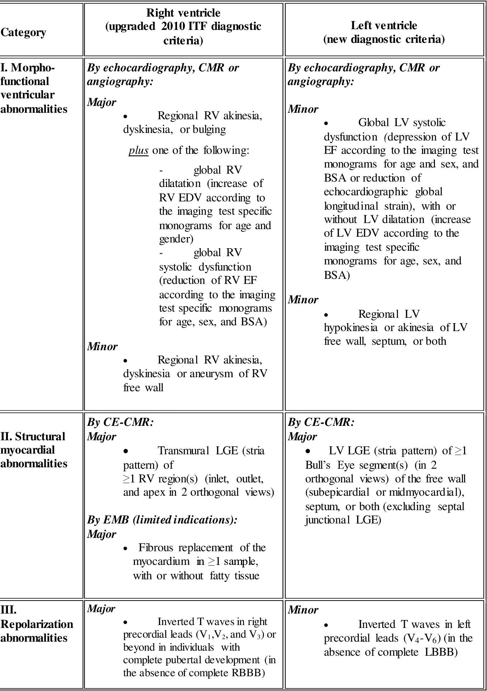
Notes:
No ECG or pathological genetic mutations or VAs are required for diagnosis
Only morpho-functional and structural abnormalities are considered
Resembles diagnostic method-similar to HCM or other structural cardiomyopathies

Slide 71
CMR in ACM
Cine CMR: Precise estimate of wall thickness, kinetics, ventricular volumes, and function
Basal inferior wall and lateral walls of RV are initially involved, and the disease progress from base to apex
Feature tracking MRI: myocardial deformation analysis
Black blood CMR: Fatty infiltration (DDx- lipomatous metaplasia). T1 mapping differentiates- lower T1(fat) and higher T1(fibrosis)
Oedema CMR: myocardial injury in early stages of the disease
Flow CMR: Rule out intracardiac shunts
Notes:
Presence of myocardial fat is per se neither a sign of disease nor a sign of ACM, because physiological fat accumulation can be seen in RV anterolateral wall and apical wall and outflow tract among healthy individuals without RV thinning/ dysfunction
Cine images: Newer planes include RV inflow, saggital RVOT, transaxial plane

Slide 72
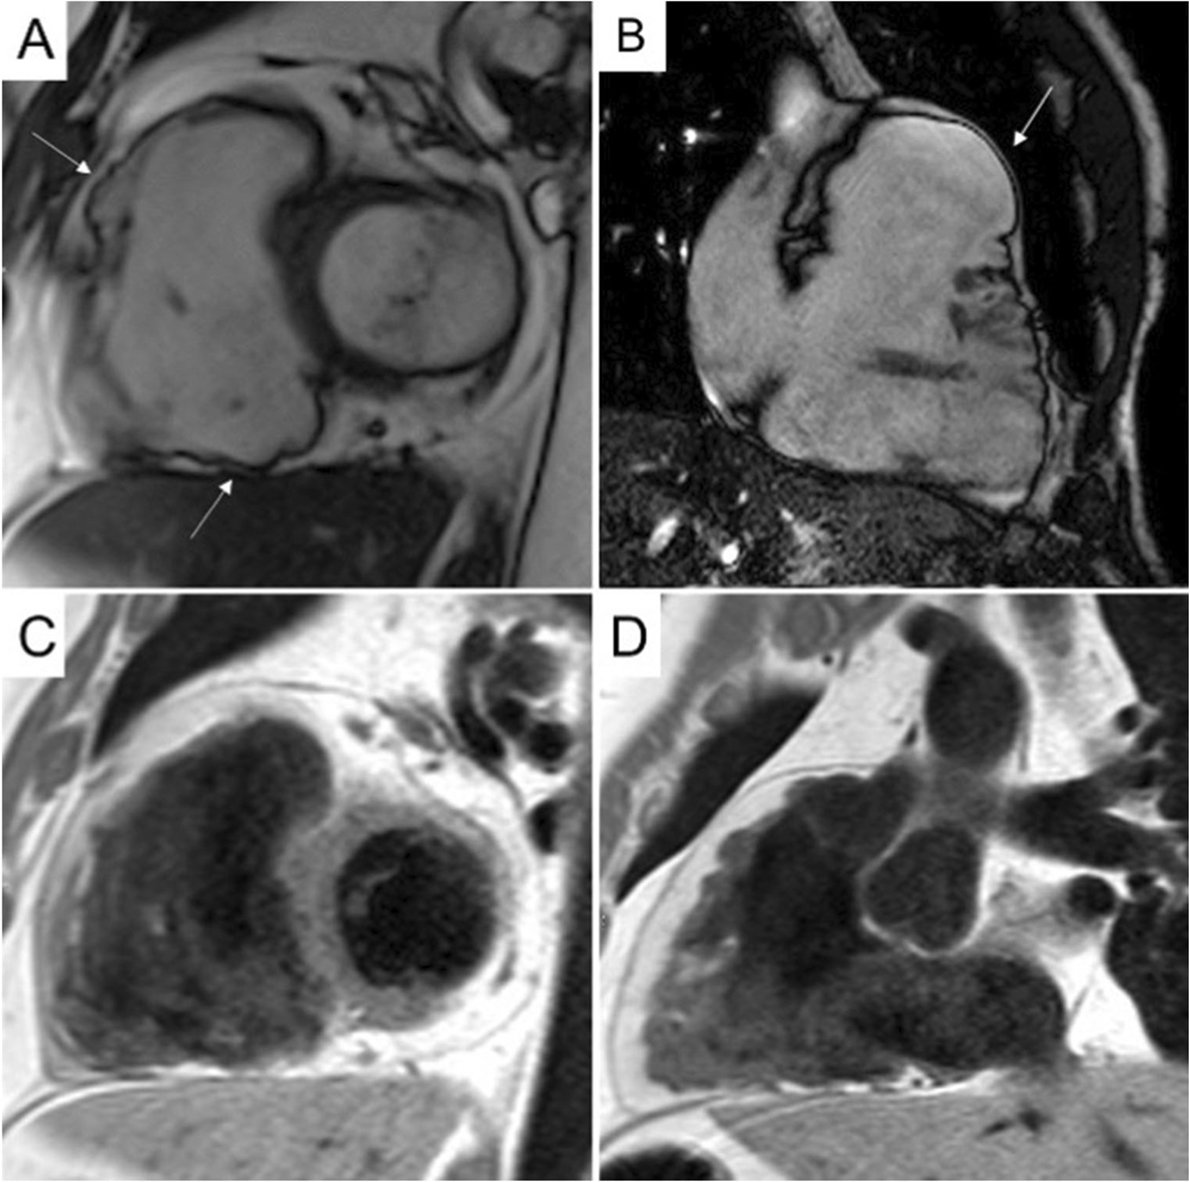
Notes:
A and B: Cine images showing multiple sacculation of RV
C and D: T1W images massive fatty infiltration- fat appearing as white inside the RV free wall

Slide 73
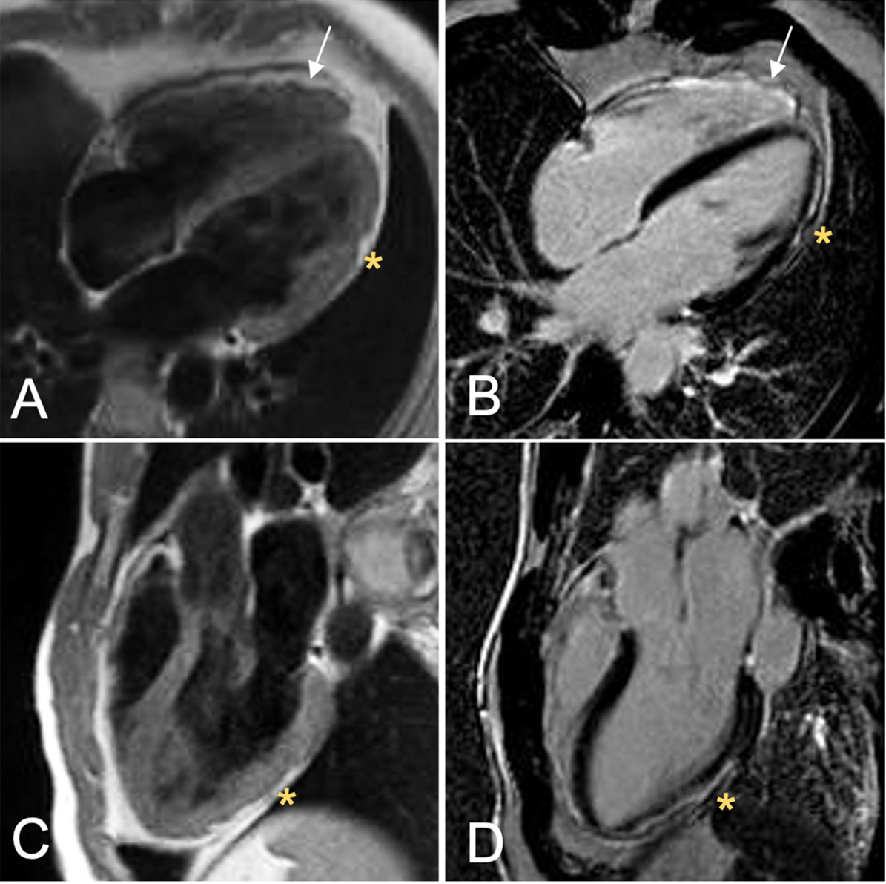
Notes:
Case of biventricular ACM
A: T1W image showing fibrofatty infiltration of RV apex and anterolateral wall
B: Post-contrast
C and D: Three chamber view showing inferolateral LV involvement

Slide 74
CMR in ACM
High NPPV for cardiac events with a normal CMR in ARVC
Strain imaging- differentiating ARVC from subclinical disease and idiopathic VT syndromes
Accordion sign: focal crinkling of the myocardium due to regional dyssynchronous contraction in the sub-tricuspid region
LGE- circumferential, mid-myocardial/sub-epicardial pattern (ring pattern)
Limitations of LGE:
Thin RV wall
Distinguishing fat from fibrosis by LGE sequences is challenging
LV LGE has wide range of differentials
Notes:
Limited yield of positive RV LGE- low resolution, limited thickness of RV, hyperintense signals coming from blood an adipose tissue

Slide 75
Mimics of ARVC
Apical-lateral bulging of RV- site of insertion of moderator band
Butterfly apex- normal variant of separate RV and LV apices causing RV apex to look dyskinetic
Tethering of anterior wall of RV to posterior sternum
Myocarditis and sarcoidosis

Slide 76
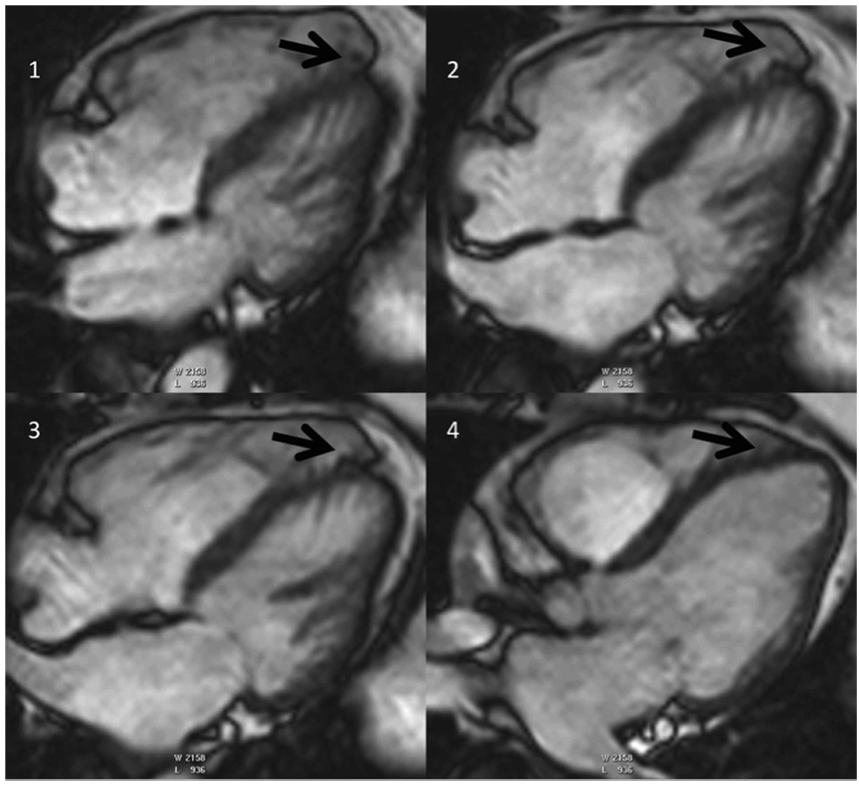
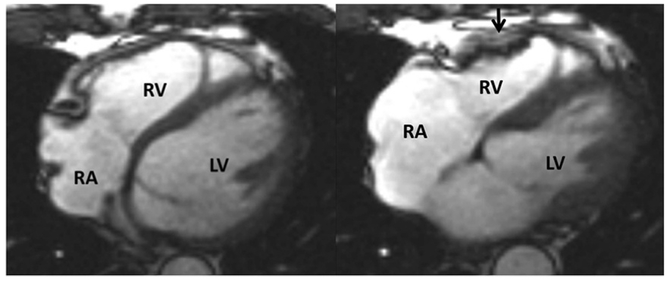
Notes:
Left: Butterfly apex-normal anatomical variant of separate RV and LV apices causing the RV apex to look dyskinetic
Right: End-diastolic and end-systolic images showing regional dyssynchronous contraction in the sub-tricuspid region

Slide 77
Genotype-phenotype correlations
Mutation in phospholamban or desmoplakin gene: significant left-dominant/ biventricular disease expression and a higher prevalence of HF
Plakophilin-2 mutation carriers: right-dominant ARVC with focal LV disease with only mild to moderate LV dysfunction

Slide 78
Sarcoidosis
Multisystem granulomatous disease of unknown aetiology
Presents in tandem or can even be isolated sign of sarcoidosis
Restrictive LV pattern
Non-dilated LV, preserved LV function, restrictive filling pattern and atrial enlargement
Myocardial granulomas- Intramural/ Spotty/ Involves basal septum and free wall

Slide 79
Sarcoidosis (cont.)
Myocardial oedema, necrosis, and scarring
Septal thinning, local dyskinesia, and ventricular aneurysm
LGE involves basal LV segments and RV side of the septum
Patchy, non-ischemic, mid-myocardial and epicardial distribution
‘Hook sign’ or ‘Hug sign’: LGE of the septum continuing into the free wall of ventricles
Extent of LGE: percentage of LV mass or number of involved segments

Slide 80
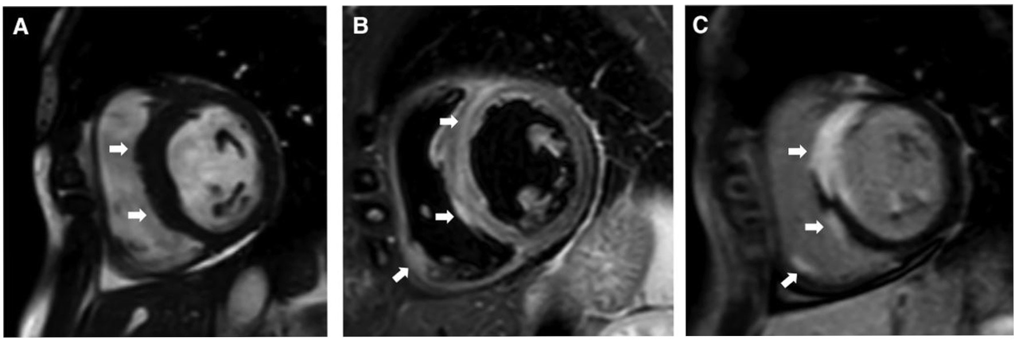
Patient with III AV block. Septal thickening, oedema of septum and right ventricle with late gadolinium enhancement of transmural septum and local RV free wall

Slide 81
Patient with III AV block with depressed LV function. CMR shows thinning of septum with patchy LGE of LV free wall

Slide 82
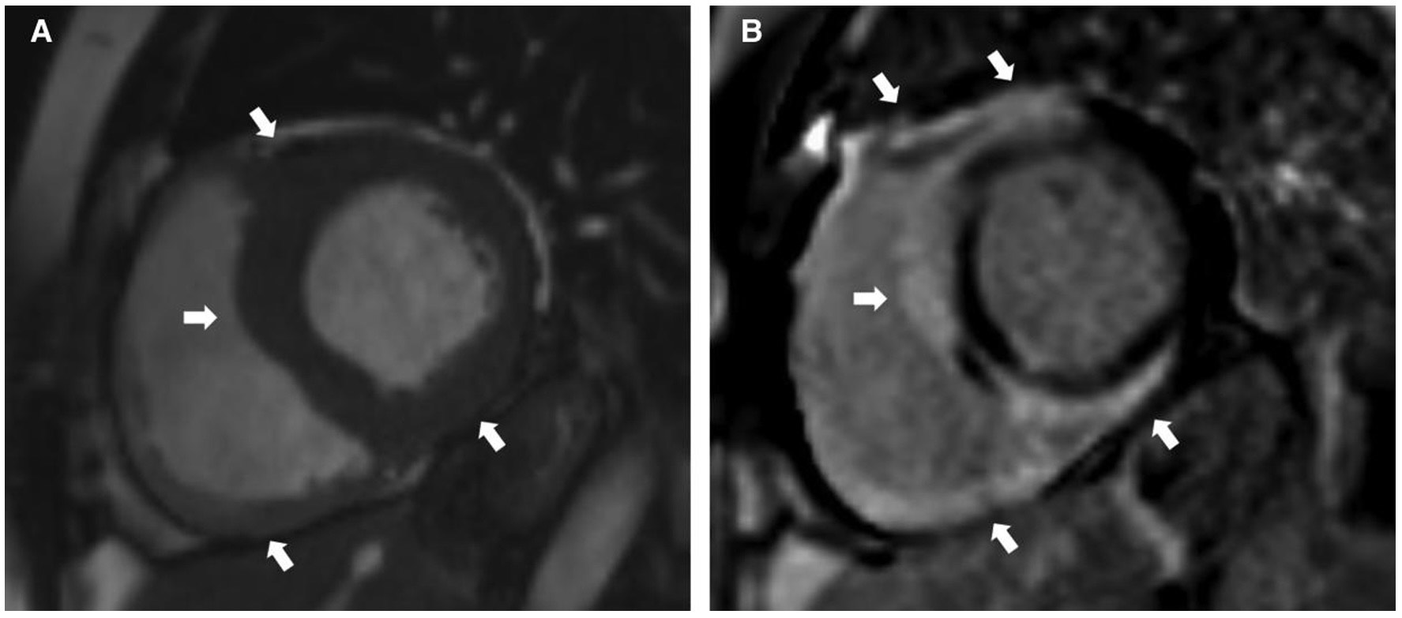
Patient with RBBB, monomorphic VT. CMR shows thickening of the LV free wall, septum, inferior RV. Characteristic “Hook sign” pattern of cardiac sarcoidosis

Slide 83
Cardiac amyloidosis
Diagnosed by positive EMB or positive extracardiac biopsy with unexplained LVH > 12mm
Clinical phenotypes: HFpEF, ASH, neuropathy, orthostatic hypotension, atrial fibrillation, microvascular dysfunction
Cine cardiac MRI-
Assess myocardial morphology and global and regional heart function
LV thickening- symmetrical/asymmetrical
Asymmetrical septal hypertrophy- ATTR > AL
Thickening of RV and atrial walls and interatrial septum
Reduced LV volumes
Notes:
Extracardiac inv- B/L CTS, spinal canal stenosis, rotator cuff tear, peripheral and autonomic neuropathy, proteinuria, chronic diarrhoea, weight loss
AL- derived from immunoglobulin light chain
ATTR- formed from transthyretin protein produced in liver
Red flags in ECHO:
Pleural or pericardial effusion
Thick RV
Thick valves
Thick IAS Low stroke volume
Paradoxical low flow low gradient AS
Restrictive LV filling
Decreased GLS with apical sparing
Posterior right atrial wall thickness >6mm

Slide 84
Notes:
Diffuse hypokinesia of LV and RV in CA in four chamber view and short axis view

Slide 85
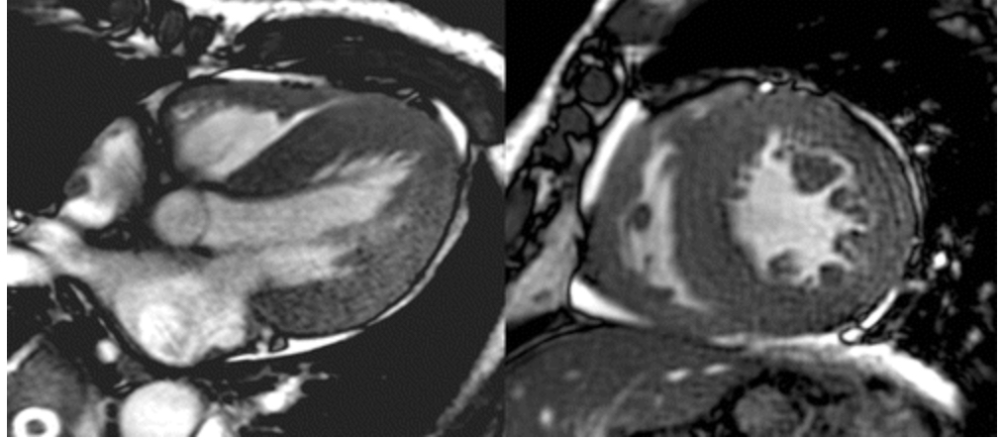
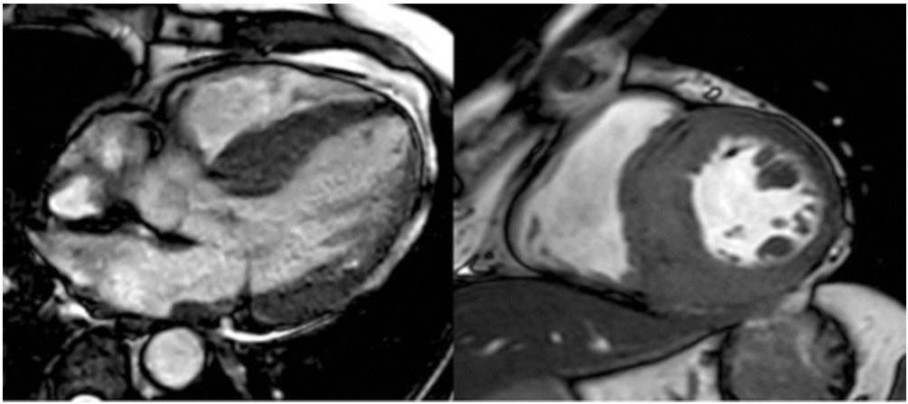
Notes:
Symmetric and asymmetric thickening in cine cardiac MR
Asymmetric pattern of LV thickening- leads to misdiagnosis as HCM (ATTR > AL)- sigmoid and reverse septal contours

Slide 86
Cardiac amyloidosis(cont.)
LGE MRI
Highly specific and sensitive: corresponds to interstitial amyloid deposition and subendocardial fibrosis consequent to ischemia
Global subendocardial LGE distributed in non-coronary distribution
Other patterns: diffuse transmural, localised patchy and subepicardial LGE
Basal > apical segments (Heterogenous mechanical dysfunction)
LGE also found in atrial, AV valves, RV
More extensive with ATTR than AL
RV involvement is common with ATTR
Pitfalls: Diffuse disease of entire myocardium
Notes:
Difficulty in nulling the myocardium with myocardial nulling before blood pool is strongly s/o CS with high sensitivity (100%)

Slide 87
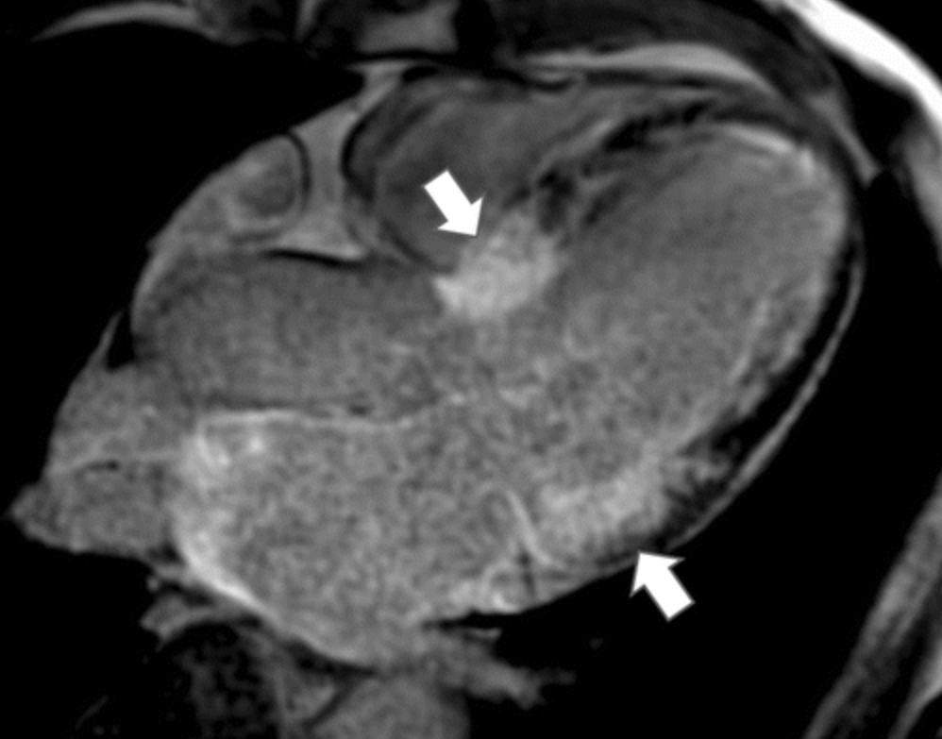
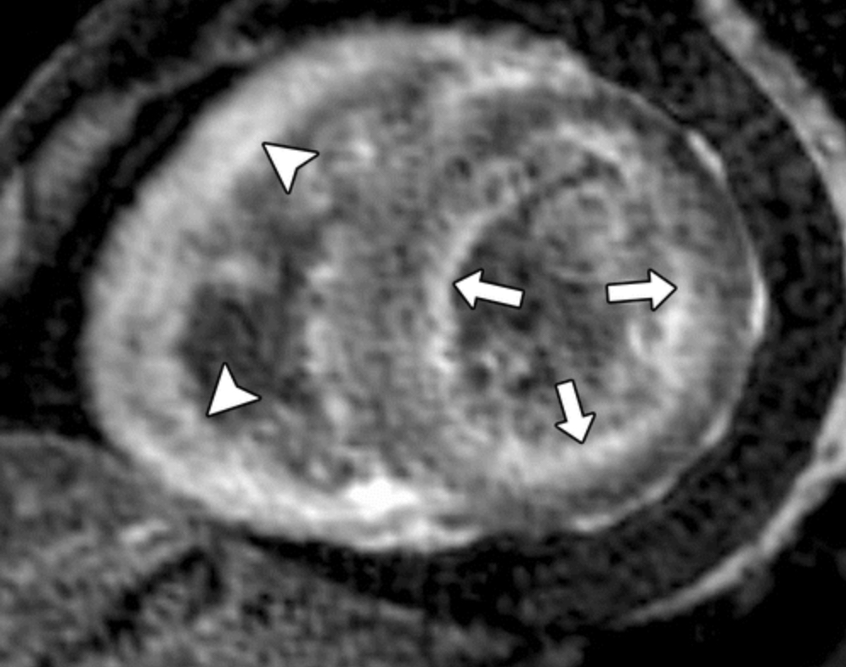
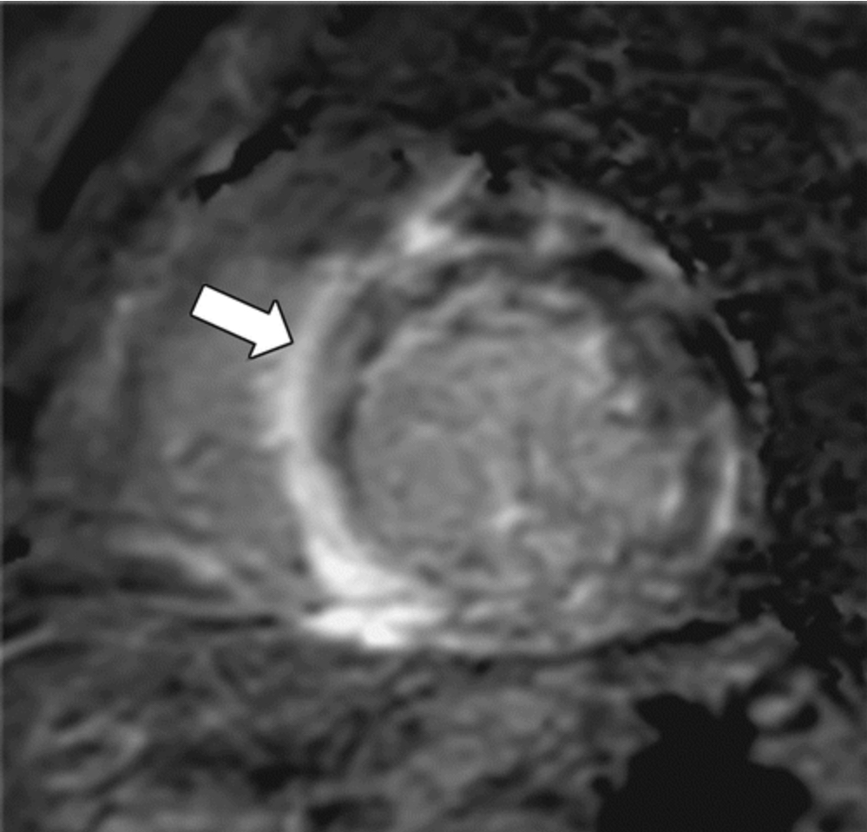
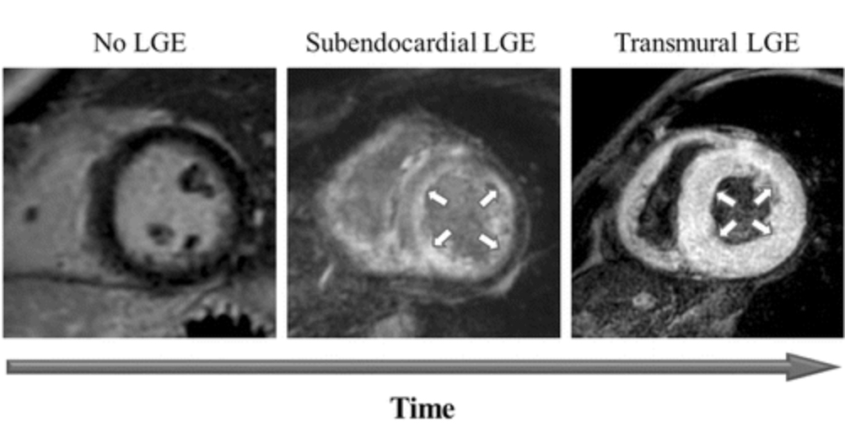
Notes:
A-Base to apical gradient- increased LGE at base relative to apex of myocardium
B-Global LV subendocardial LGE with dark blood pool
C- Subepicardial

Slide 88
Cardiac amyloidosis (cont.)
T1 mapping:
Native T1 mapping: reflects the myocardial diseases involving myocyte and interstitium without use of Gd-based contrast agents
Contrast enhanced T1-mapping enables calculation of ECV fraction
Native T1 signal is higher with AL than with ATTR
ECV is higher with ATTR
Inversion scout images acquired 5 minutes after, causes myocardium to attain null point even before blood pool does
Predictive of mortality

Slide 89
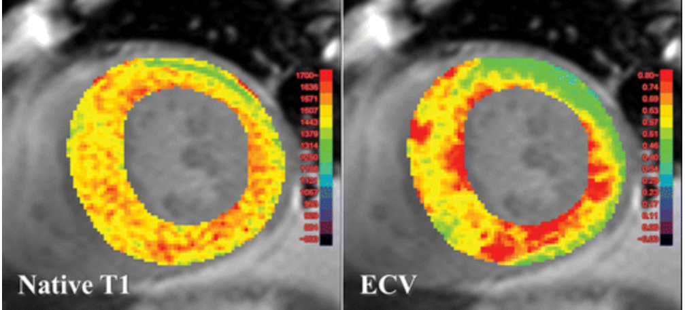
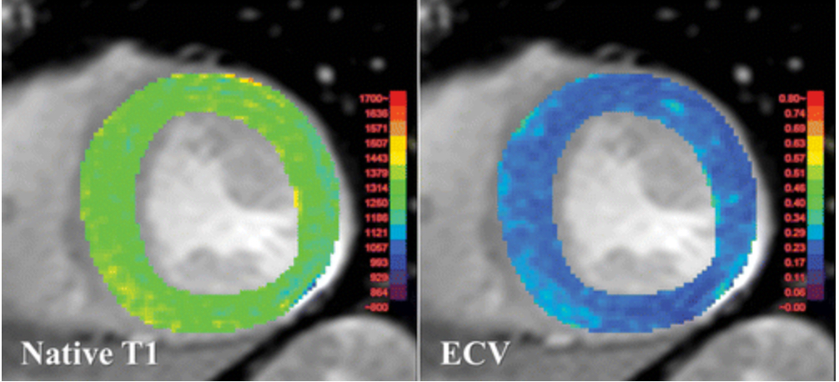
Notes:
In contrast to ECV, which characterizes the extracellular space, the native T1 values provide a combined signal from myocyte and extracellular space and reflect changes in either or both of those tissue compartments
Top- Elevated mean native T1 and ECV values in CA patient compared to non amyloid related HF (bottom)

Slide 90
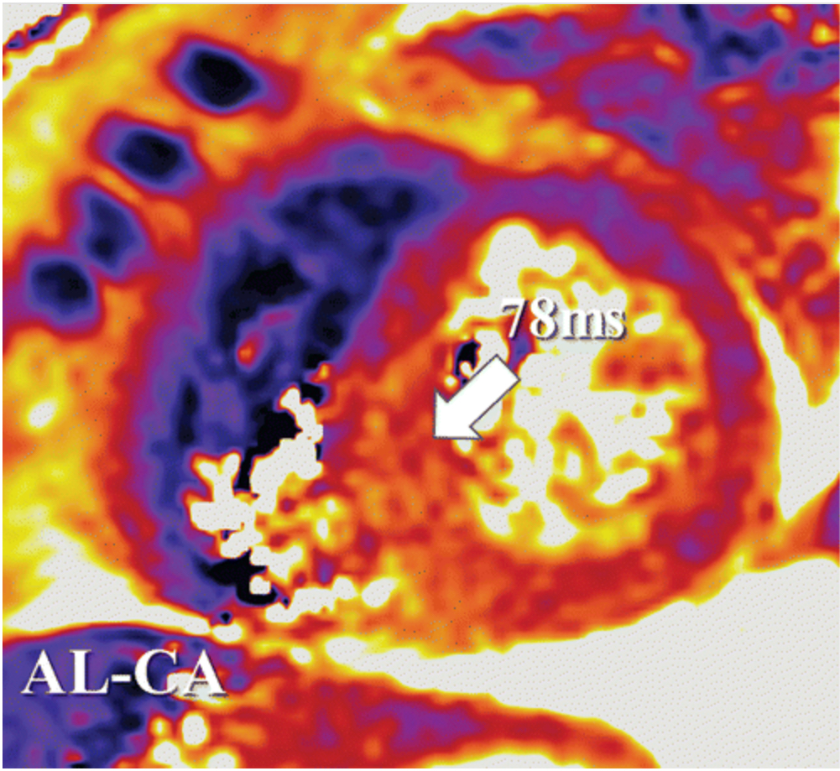
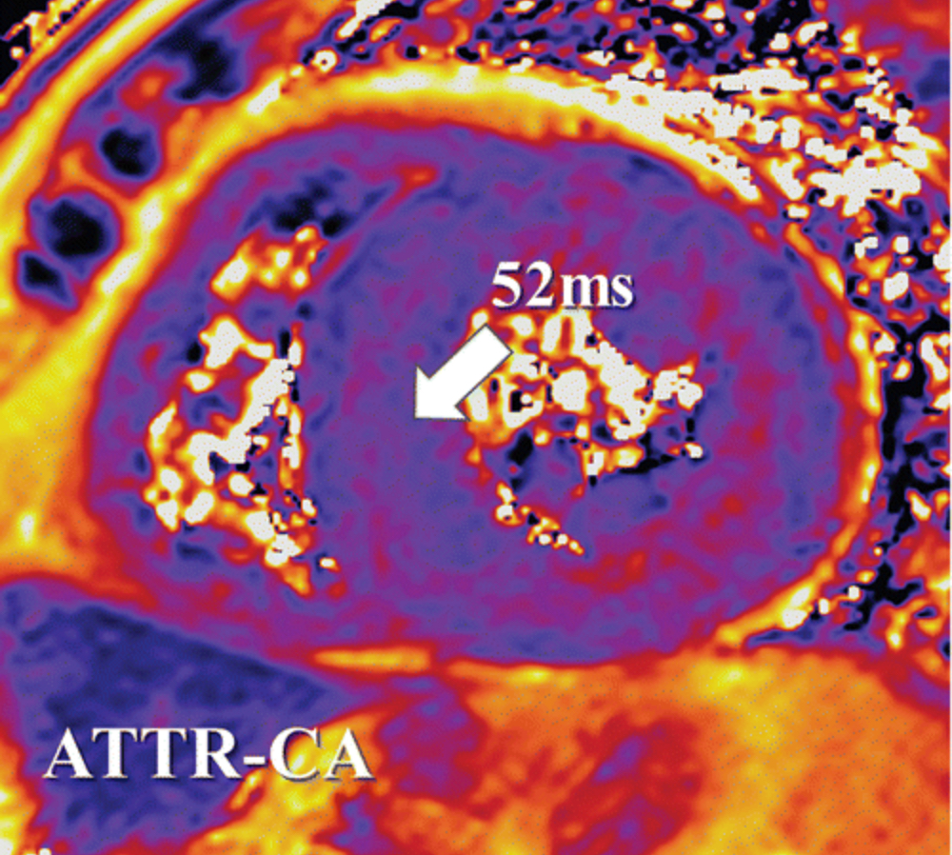
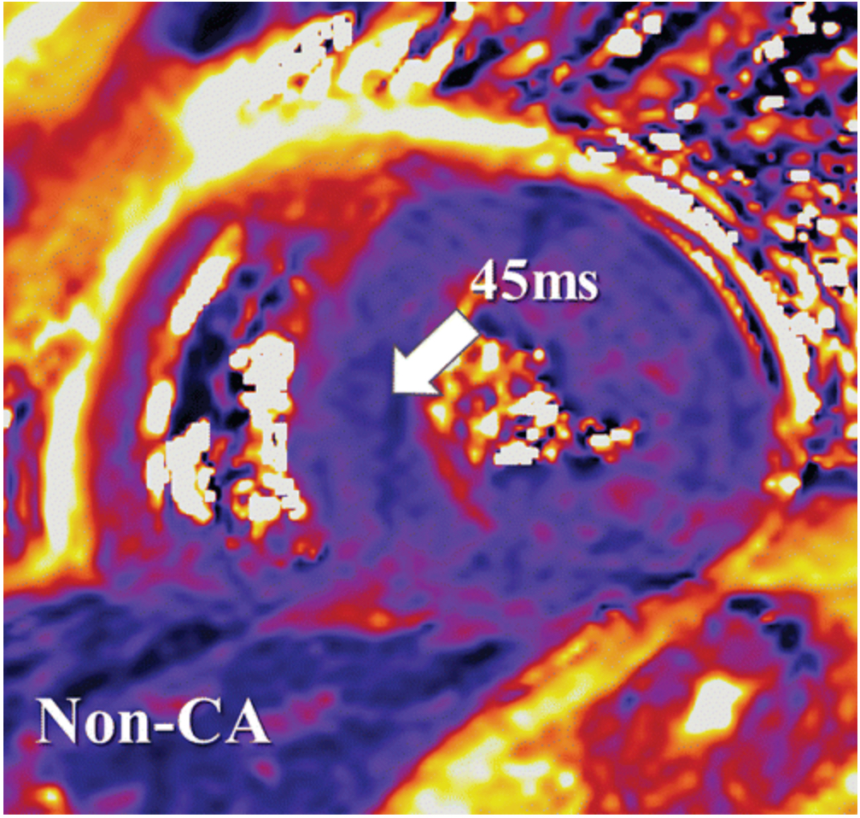
Cardiac amyloidosis (cont.)
T2 mapping: Quantification of local myocardial inflammation and oedema
Notes:
T2 values elevated in AL > ATTR > Non-cardiac CA

Slide 91
Fabry’s disease
Rare progressive X-linked inherited disorder of glycosphingolipid metabolism
Deficiency of alpha-galactosidase A enzyme
Leading to accumulation of globotriaosylceramide accumulation within lysosomes of major organs
Activates secondary pathways- cytokine production, coagulation activation and oxidative stress
Frequent misdiagnoses and significant diagnostic delays (Idiopathic LVH)
Reduced life expectancy
Notes:
Lysosomal disorder
Cardiomyopathy results from progressive GL3 accumulation in myocytes, valvular fibroblasts, conductive tissue, microvascular endothelium, and smooth muscle cells.
C/F- progressive left ventricular thickness, LV dysfunction, arrhythmias, valvular heart disease and myocardial ischemia
Diagnostic challenge- distinguishing FD cardiomyopathy from other forms of unexplained LVH
Definitive diagnosis- enzyme assay or genetic testing, not tissue biopsy

Slide 92
CMR in Fabry’s
Structural evaluation
Concentric LVH at beginning
Later develops asymmetrical hypertrophy with grossly thickened septum to inferolateral wall
RV hypertrophy can develop
Functional evaluation
Decreased ventricular compliance, increasing filling pressures and restricts diastolic filling
Feature-tracking CMR (FT-CMR)- strain rate analysis in cardiac diseases
Notes:
FD is different from other interstitial cardiomyopathies- GL3 accumulation is intracellular, resulting in true increase in LV myocyte mass and a reactive LVH.
Impairs ventricular compliance, increases LV filling pressures, and restricts diastolic filling, causing heart failure
Base to apex circumferential strain (CS) gradient measured on FT-CMR is lower in FD than compared to healthy volunteers

Slide 93
CMR in Fabry’s
Tissue characterization
LGE involving basal and mid inferolateral myocardium
T1 mapping- reduced in reduced in early stages but tend to increase in advanced staged due to replacement fibrosis and ongoing inflammation (same holds for ECV)
High T2 values in early stage of myocardial involvement, later corresponding to areas of LGE
ECV values are normal in FD, however, may increase as the disease progresses due to infiltrative fibrosis
Notes:
Accumulation of sphingolipids inside the lysosomes in FD significantly shortens the native T1 values.
Pagano et al- evaluated RV myocardium with T1 mapping- low values in FD compared to PAH and other healthy volunteers
Chronic T2 elevation in LGE areas and elevations of global T2 values are both associated with poor outcomes. (FD is inflammatory and infiltrative cardiomyopathy)

Slide 94
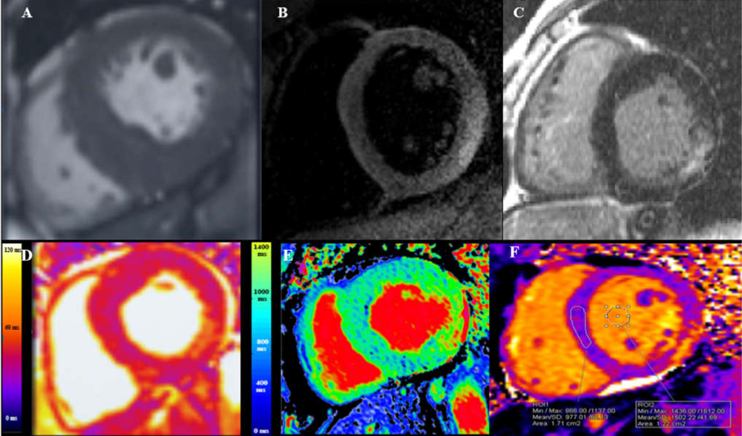
Notes:
A- SSFP cine short axis- hypertrophy of mid inferoseptum
B-Dark blood STIR sequence- myocardial oedema in BIFL
C- LGE image- mid myocardial LGE in BIFL
D- Native T2- increased value in BIFL
E- Native T1- Low values in septum
F-Pseudonormalization in septum and increased T1 values in BIFL (Advanced disease)

Slide 95
 | LVH PATTERN | LGE PATTERN | T1 MAPPING | T2 MAPPING | ECV
Fabry disease | Concentric LV wall thickening | Basal to mid inferolateral mid-myocardium | Initially reduced, later stages increased | Elevated in areas of LGE, chronic inflammation | Normal usually Late stages- replacement fibrosis
HCM | Asymmetric and anteroseptal hypertrophy | Patchy involvement in areas of hypertrophy | Patchy areas of elevated native T1 values in hypertrophies parts | Elevated T2 values in areas of tissue injury | Elevated Correlated with LGE
HHD | Concentric LVH with basal septum involvement | No LGE | Normal | Normal | Normal
AS | Concentric LVH | No LGE | High T1-mortality predictor | Inflammation/myocardial remodeling | Elevated ECV- mortality predictor
Amyloidosis | Concentric LVH | Diffuse transmural or sub-endocardial LGE (ATTR > AL) | Elevated T1 values (AL > ATTR) | Myocardial oedema Prognostic marker | Elevated ECV (ATTR > AL)

Slide 96
Iron overload cardiomyopathy
Accumulation of iron in body due to genetic metabolic disorders with increased intestinal iron absorption or frequent blood transfusions
Leading of cause of death
Progression of deposition: Epicardial to endocardium
Accumulation starts from peri-nuclear lysosomes to involve sarcoplasm
Paramagnetic effect of iron produces changes in MR signal intensity and shortens in T1 and T2 relaxation times
T2* values <20ms best defines siderosis, 10-20ms: moderate, <10ms severe iron overload

Slide 97
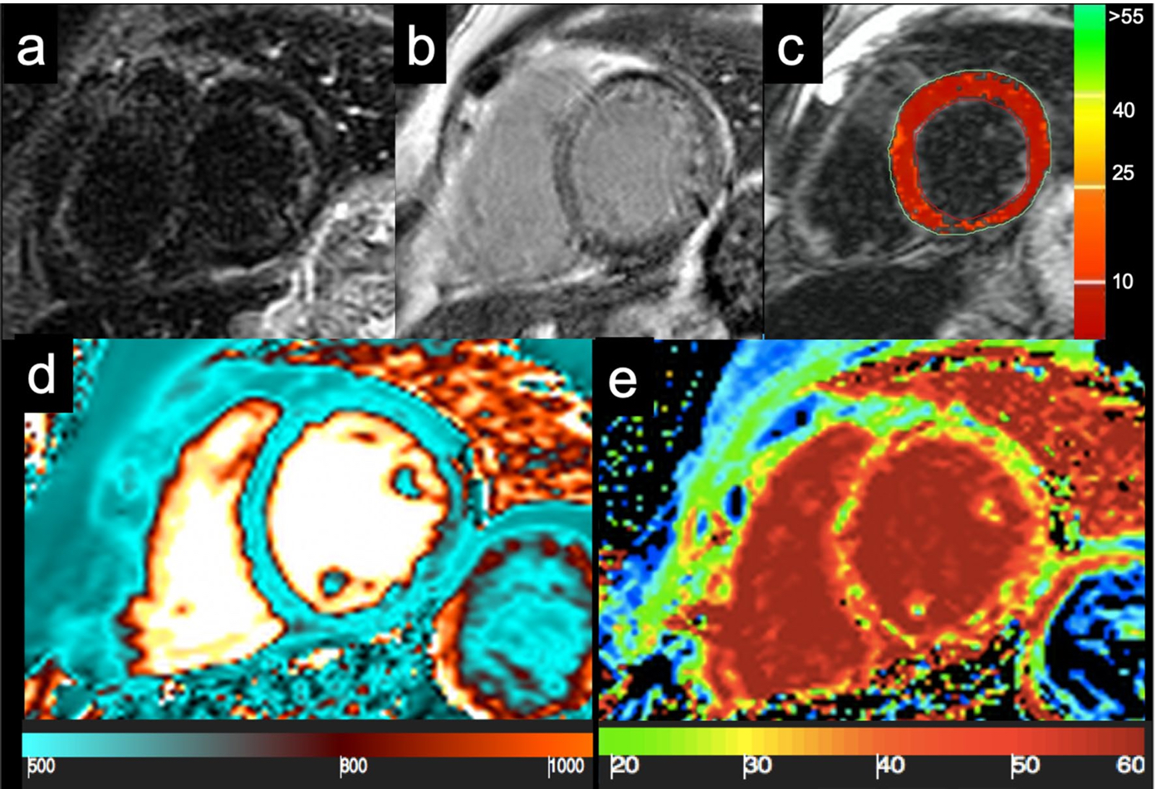
Notes:
41 year old female with Cooley’s anemia
Global myocardial hypointensity in STIR imaging
Diffuse inhomogenous abnormal signal on LGE imaging
Diffuse marked reduction in global myocardial T2* relaxation time (0-1.5 ms)
Global reduction in native T1 value
Diffuse fibrosis on ECV

Slide 98
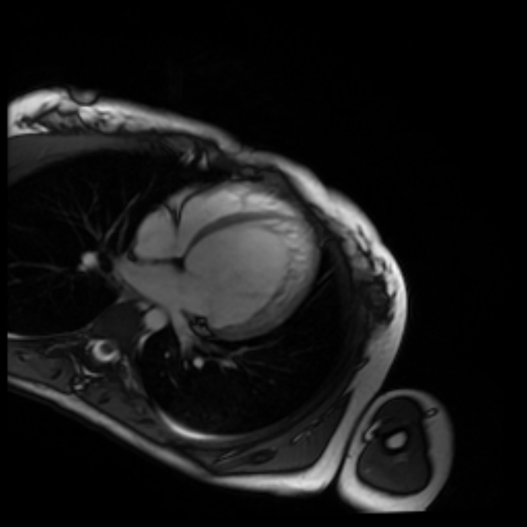
LV Non-Compaction
Primary genetic abnormality
Asymptomatic in most of the cases, but may lead to cardiac failure, thromboembolism and malignant arrhythmias
Compaction proceeds from
Epicardium to endocardium
Base to apex
Septum to free wall of LV
LV > RV
Apex in almost always involved in addition to apical anterior and inferolateral segments

Slide 99
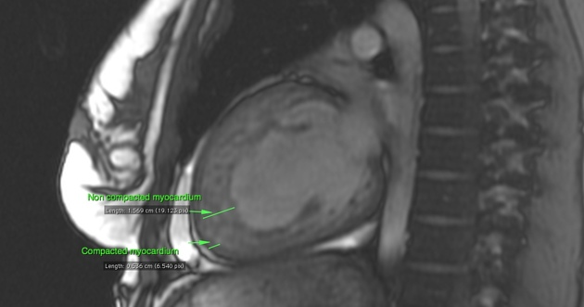
LV non-compaction (cont.)
Ratio of non-compacted to compacted myocardium of greater than 2.3 in end-diastole
Marked trabeculations and deep-intertrabecular recesses
Visual appearance of two distinct myocardial layers- compacted and non-compacted

Slide 100
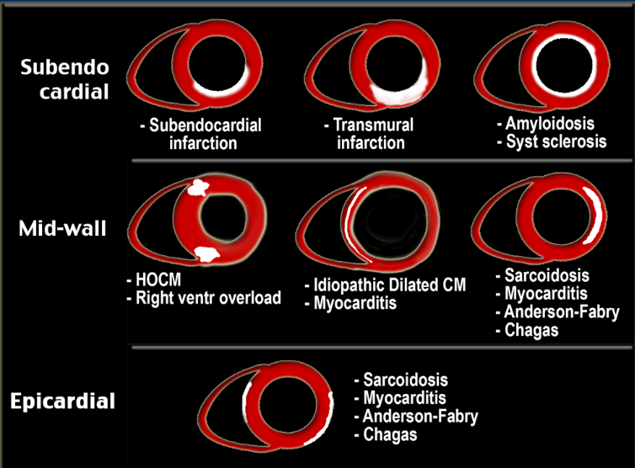

Slide 101
Conclusion
CMR provides precise assessment of ventricular function and tissue characterization in a single examination
Indication prior to imaging
Cine and LGE sequences are the pillars of CMR
LGE CMR helps in diagnosis and prognostication of various non-ischemic cardiomyopathies

Slide 102
THANK YOU

